Slide 1
RID
Address
Performs
Cust.ID
Menu ID
QRCode
Amount
RestaurantName
Table number
Category ID
Subscribed Restaurants
Add Payment method
Transaction
Confirms
Has
Table
Order ID
email
Time
Number
Cust. ID
Cust. ID
Reservation Number
Transaction ID
Name
password
Gives
Has
Menu items
Cust ID
Restaurant name
Creation time
Customer
Adds to
Name
Cust.ID
Order ID
Has
Access
Updation Time
Review
comments
RID
NumberOfOrders
Checkout
Dish name
Cart
Price
Specials
Description
Cust ID
Total Amount
PromoCode
First-time Deals
Quantity
Offer
Occasional Deals
Menu type
Soups
Advertising Deals
Has
Membership Deals
Category ID
Main Course
Desserts
Appetizers
Cuisine
Conceptual Diagram(QR Yummy)

Slide 2
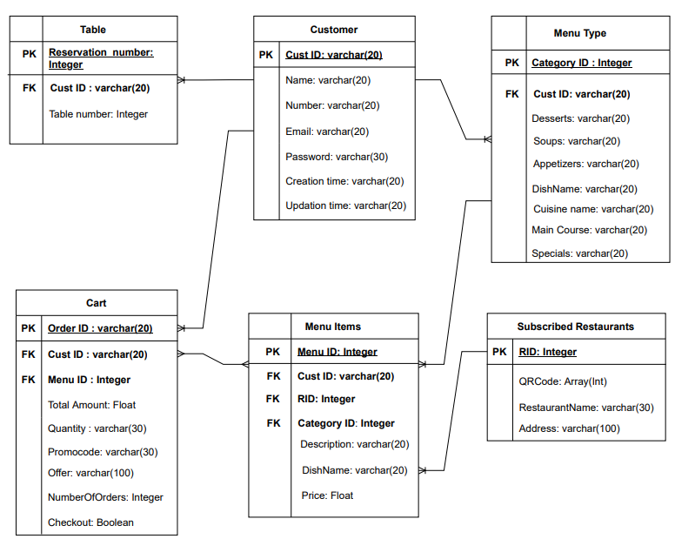
Logical Diagram(QR Yummy)

